Slide 1

390 Residential Rezone Informational Meeting
February 25, 2021

Slide 2
Welcome + Introductions
Rian Rooney, Associate Long-Range Planner
rrooney@tetoncountywy.gov
Kristi Malone, Senior Long-Range Planner
kmalone@tetoncountywy.gov
Ryan Hostetter, Principal Long-Range Planner
rhostetter@tetoncountywy.gov
Amy Ramage, Teton County Engineer
aramage@tetoncountywy.gov

Slide 3
Agenda
How We Got Here
Introducing Neighborhood Residential-1 (NR-1)
What’s Changing?
Next Steps
Questions

Slide 4
How We Got Here
1994
Comprehensive Plan and Land Development Regulations (LDRs)
2012
Jackson/Teton County
Comprehensive Plan
2016
New Rural Character Zones for LDRs
Present
Develop Complete Neighborhood Character Zones for LDRs

Slide 5
How We Got Here
“Their purpose is to implement the Jackson/Teton County Comprehensive Plan and promote the health, safety, and general welfare of the present and future inhabitants of the community.”
- Teton County LDRs Division 1.3.

Slide 6

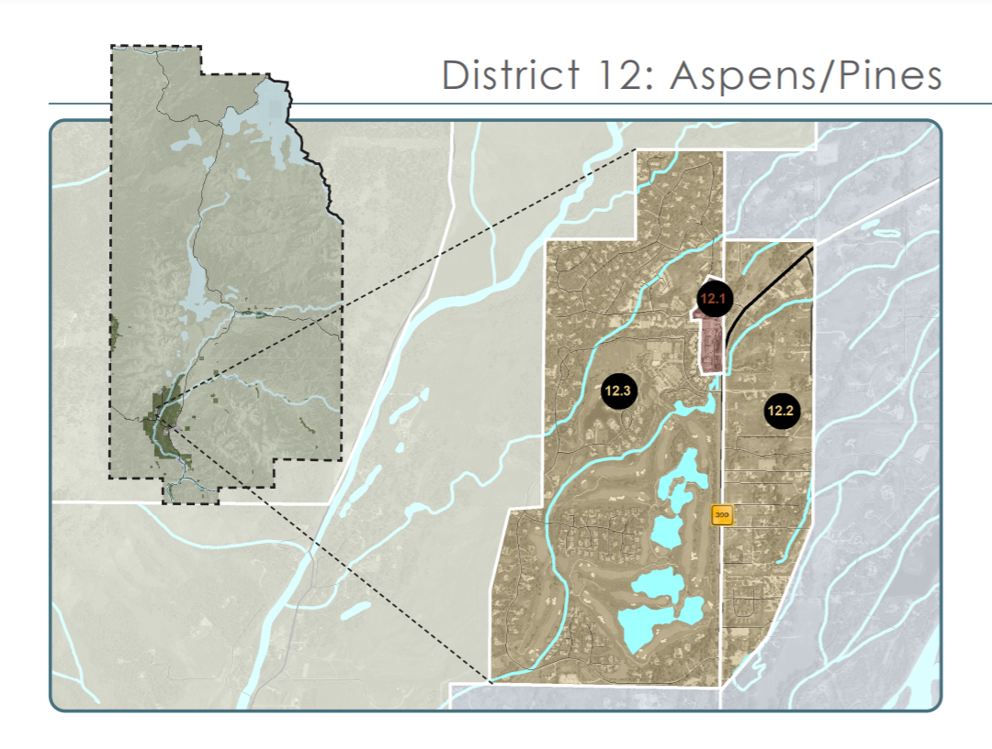
WHERE?

Slide 7
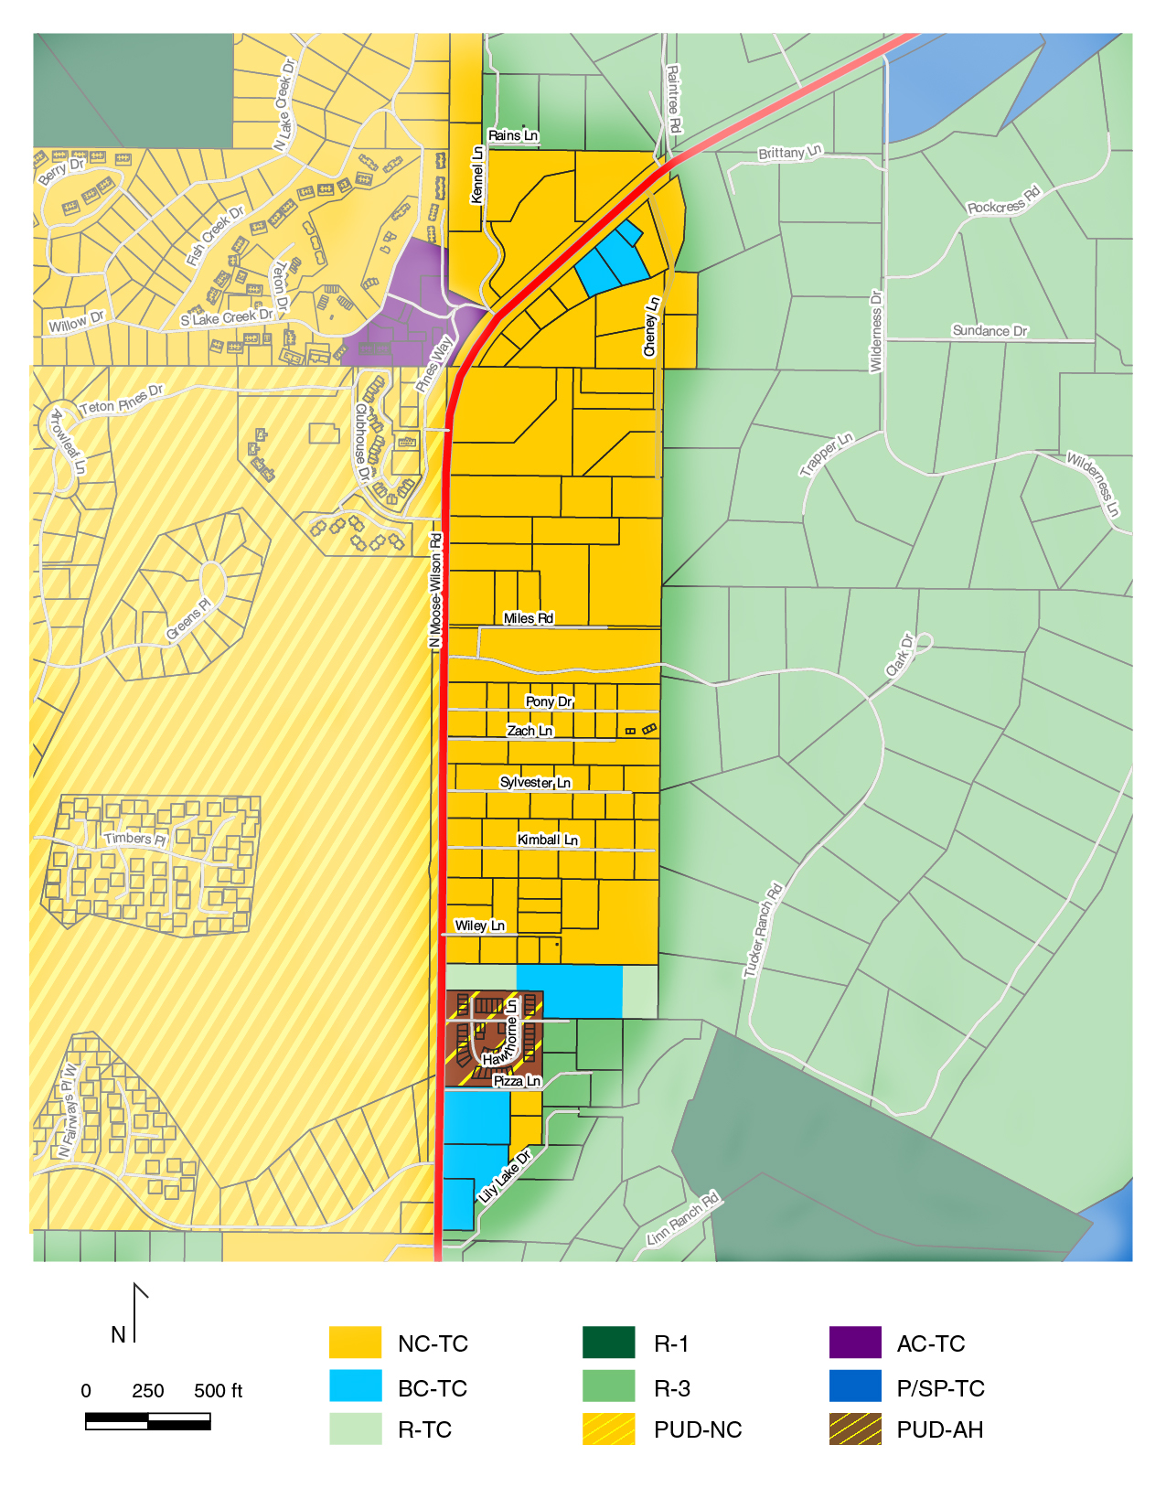
Current Zoning
Neighborhood Conservation (NC-TC)
Business Conservation (BC-TC)
Rural-3 (R-3)
Millward PUD

Slide 8
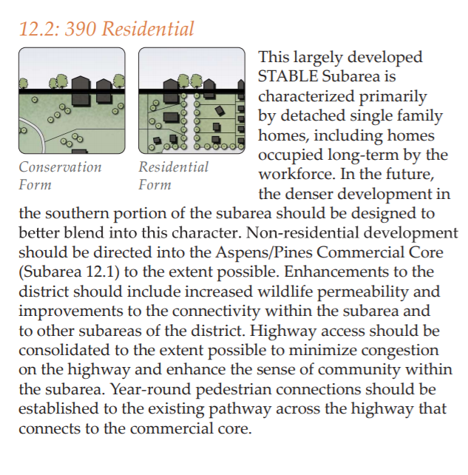
Comprehensive Plan Vision
Stable
Single-Family
Redirect Commercial
Connectivity
Wildlife Permeability

Slide 9
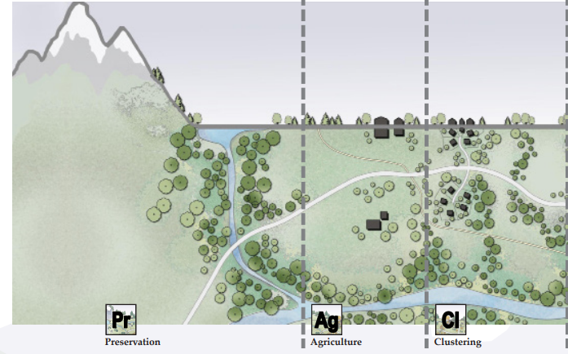
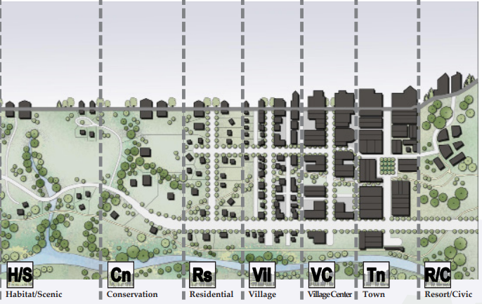
Neighborhood Form

Slide 10
Your Feedback
August 12, 2020 Neighborhood Meeting
Written Comments
December 2020 – January 2021 Online Survey

Slide 12
Zoning Goals
Preserve riparian areas and permeability
Maintain open space and landscape
Honor existing development rights
Easier to use

Slide 13
Neighborhood Residential-1 (NR-1)
Purpose: “Allow for the exercise of property rights in a way that allows for wildlife permeability and the preservation of open space to provide a predominance of landscape over built form.”
Use: Detached Single-Family Residential
Density: 3-acre minimum lot size
Predictability and clarity
Flexibility for property owners

Slide 14
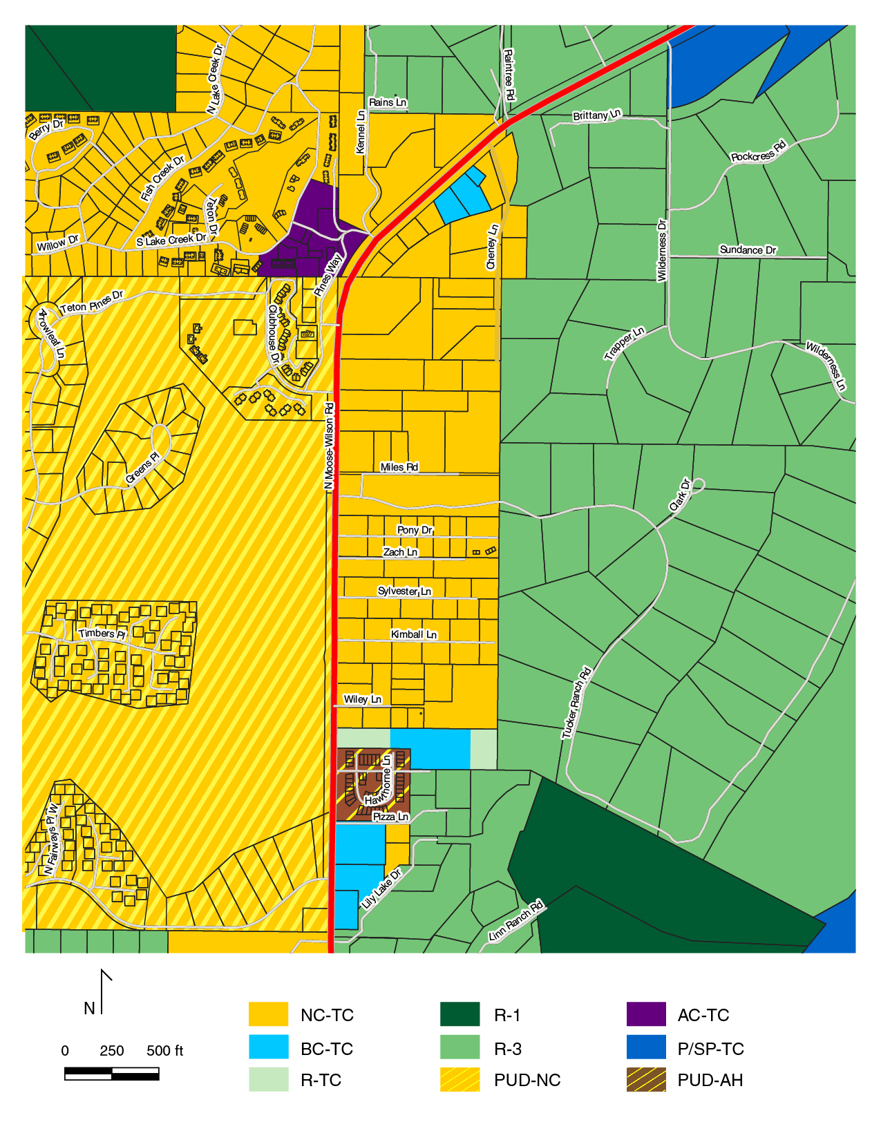
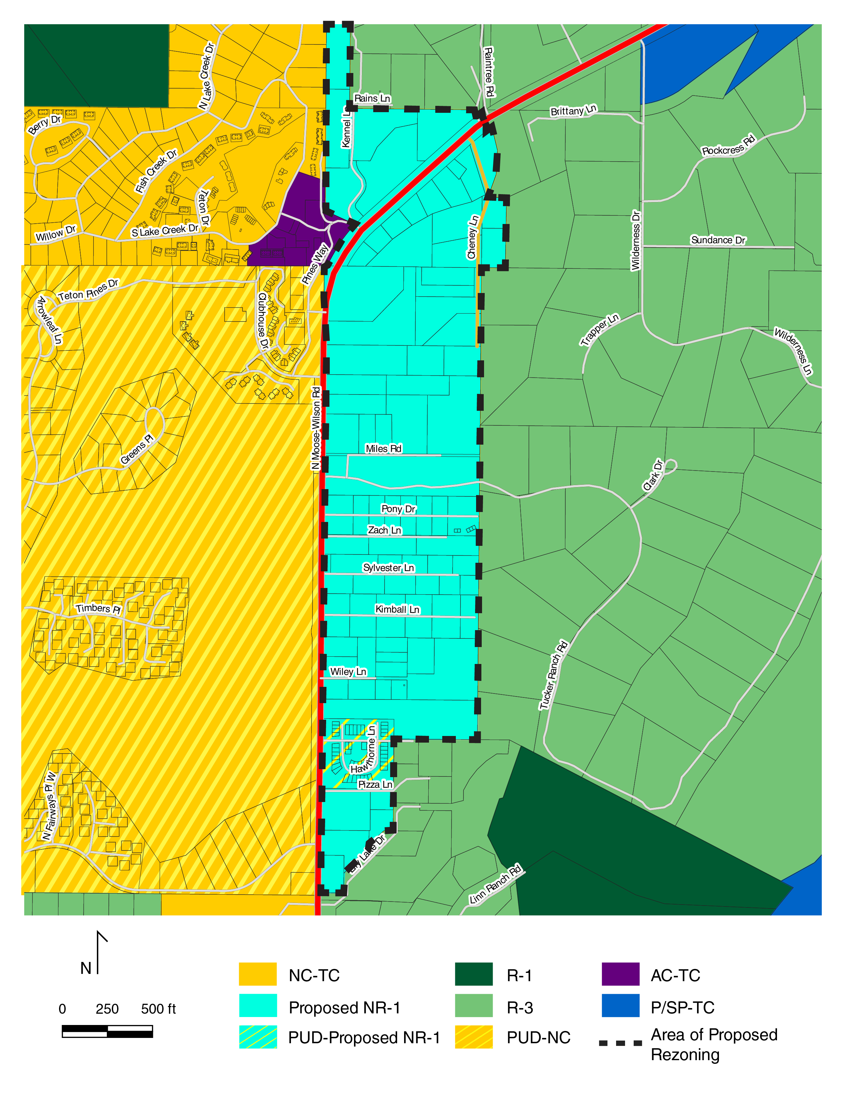
Current Zoning
Proposed Zoning
Notes:
Current vs. proposed

Slide 15
What’s Changing? (Residential)
Same | Changed
Environmental & Scenic Standards | Maximum Site Development (more flexible)
Fencing Standards | Maximum Floor Area (more flexible)
Grading, Erosion & Stormwater | Land Division (simplified)
Natural Hazard Protection Standards | Site Development Setbacks (simplified)
Lighting & Noise | Allowed Uses (remove Outdoor Recreation)
Structure Height | Signs (simplified)
Structure Setbacks
Landscaping Standards
Required Physical Development Permits
Infrastructure Requirements
Operational Standards

Slide 16
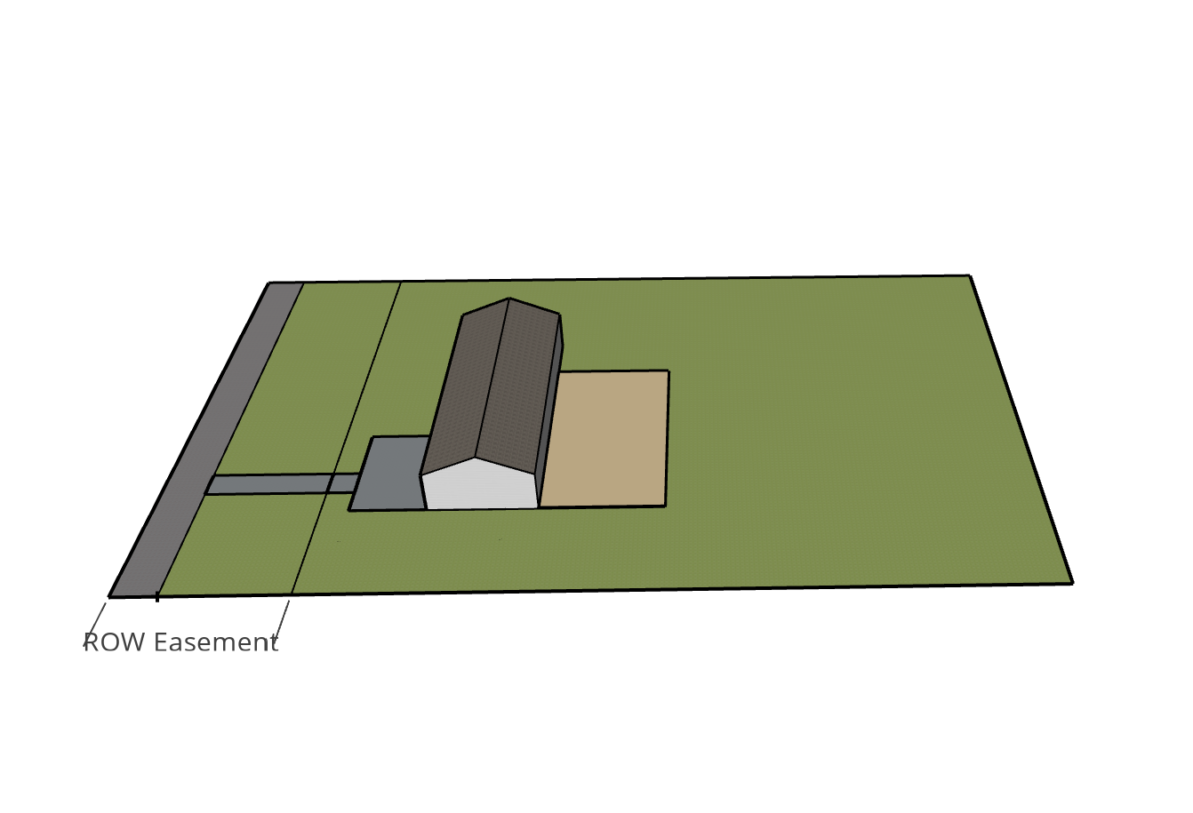
Maximum Site Development + Floor Area
Added flexibility
Lot Area: 100,000sf (2.3 acres)
Encumbered with ROW easement

Slide 17
Maximum Site Development + Floor Area
Example:
Lot Area: 100,000sf (2.3 acres)
Encumbered with ROW easement
Lot Area: 100,000sf (2.3 acres)
Encumbered with ROW easement

Slide 18
Maximum Site Development + Floor Area
Current Allowance (NC-TC)
Max. Floor Area : 6,500sf
Max. Site Development : 14,500sf
Adjusted Lot Area: 100,000sf – 19,000sf = 81,000sf (1.9 acres)
Encumbered with ROW easement

Slide 19
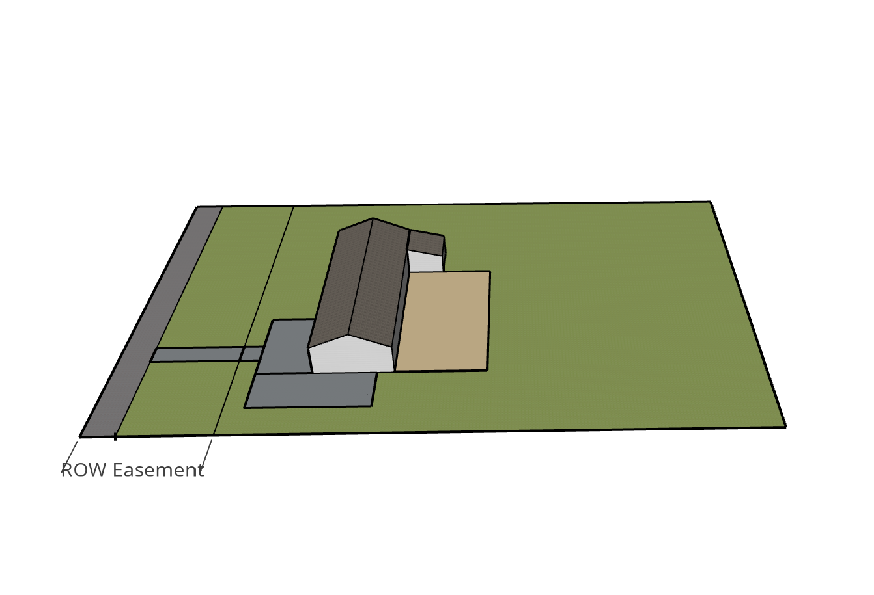
Maximum Site Development + Floor Area
Proposed Allowance (NR-1)
Max. Floor Area: 7,100sf
Max. Site Development: 16,600sf
Lot Area: 100,000sf (2.3 acres)
Encumbered with ROW easement

Slide 20
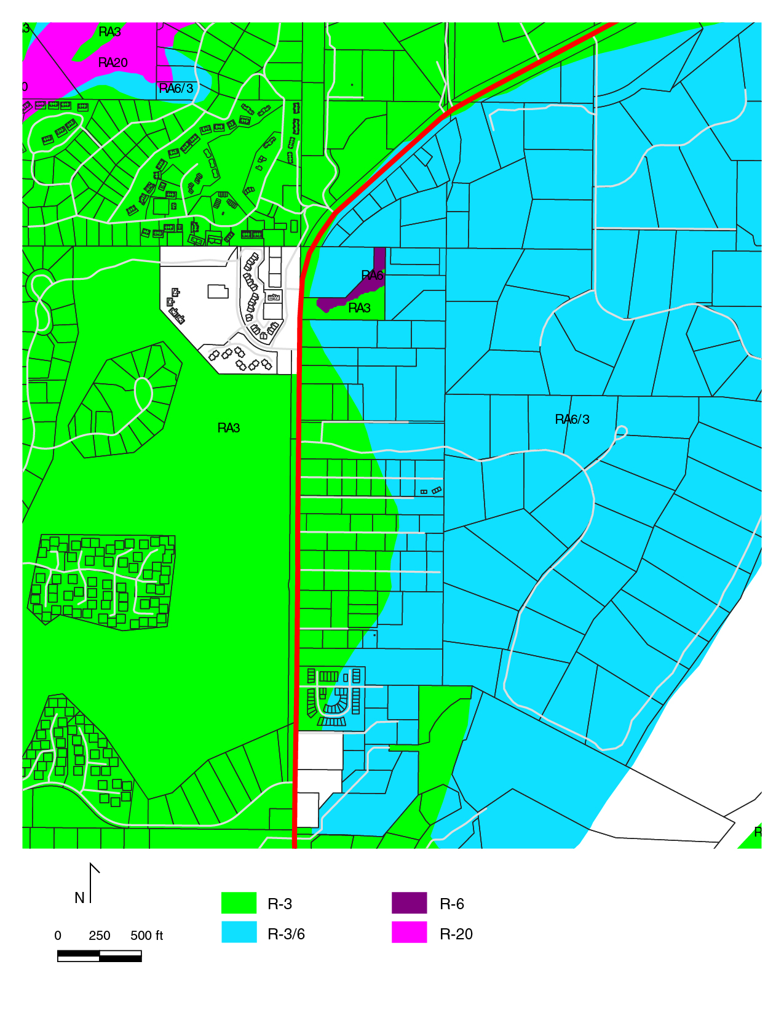
Land Division
Current NC-TC
1978 Land Use Map
3/6-acre minimum lot size
Requires groundwater measurement

Slide 21
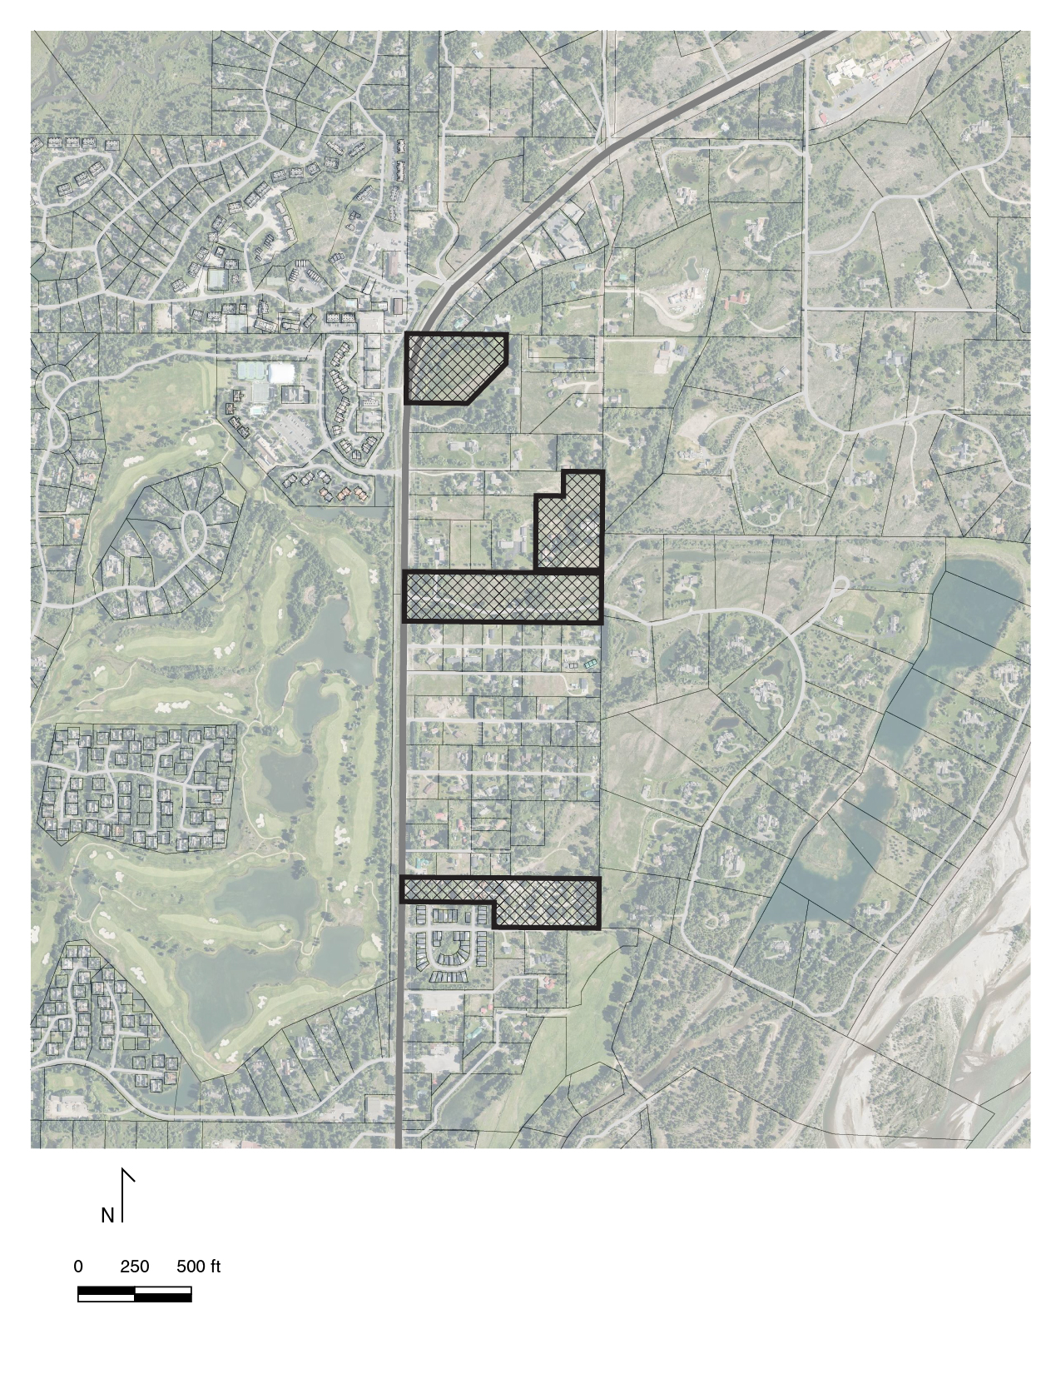
Land Division
Simplified
No measurement required
3-acre minimum lot size
Wildlife permeability
Traffic impacts
Water quality
Four parcels are 6+ acres

Slide 22
Site Development Setbacks
Side and rear setbacks unchanged
Street setback NC-TC
“40% of lineal frontage: 1/2 the structure setback”
“60% of lineal frontage: structure setback”

Slide 23
Site Development Setbacks
Side and rear setbacks unchanged
Street setback NR-1
Simplified to current minimum
<3 acres: 12.5’
≥3 acres: 25’

Slide 24
Uses
Outdoor Recreation removed as an allowed, conditional use
Equestrian centers, outdoor reception sites, golf courses, ski areas etc.
More appropriate for rural areas with large lots

Slide 25
Signs
Simplified
Current NC-TC Allowance
Varies: commercial vs. residential, <3 acres vs. ≥3 acres

Slide 26
Signs
Simplified
Current NC-TC Allowance
Varies: commercial vs. residential, <3 acres vs. ≥3 acres
Proposed NR-1 Allowance

Slide 27
Signs
Simplified
Current NC-TC Allowance
Varies: commercial vs. residential, <3 acres vs. ≥3 acres
Proposed NR-1 Allowance
1 rustic freestanding sign or 1 wall sign
Height: 4 feet
Area: 4 sf

Slide 28
Summary Slide
Residential
Flexibility for site development and floor area; easier to calculate
Land division: 3 acre minimum
Site development street setback simplified
Removed Outdoor Recreation
Allowed signage simplified
Commercial/Nonresidential
Varies by site
Let’s talk

Slide 29
Next Steps
Still a draft
March 22, 2021: Planning Commission
April 13, 2021: Board of County Commissioners
Please send public comment to rrooney@tetoncountywy.gov

Slide 30
Resources
Project page: jacksontetonplan.com/390rezone
Teton County Land Development Regulations: jacksontetonplan.com/31/Land-Development-Regulations
Jackson/Teton County Comprehensive Plan: jacksontetonplan.com/270/Comprehensive-Plan
Contact Information
Rian Rooney, Associate Long-Range Planner
rrooney@tetoncountywy.gov
307-733-3959

Slide 31
Thank You

